Slide 1
Limits to Selection in U.S. Dairy Cattle After Several Generations of Genomic Evaluation
John B. Cole* and Daniel J. Null
Council on Dairy Cattle Breeding
Bowie, Maryland, USA

Slide 2
Topics
Materials and methods
Estimated selection limits
What’s the best animal we can make?
Discussion and conclusions

Slide 3
Materials and methods

Slide 4
Animals and traits included
Genotypes imputed to 69,200 SNP
Ayrshire (AY): 20,373
Brown Swiss (BS): 89,136
Guernsey (GU): 11,407
Holstein (HO): 9,119,871
Jersey (JE): 928,883
Milk, fat, and protein yields
Productive life (PL)
Somatic cell score (SCS)
Daughter pregnancy rate (DPR)
Heifer & cow conception rates (HCR & CCR);
Heifer & cow livabilities (HLIV & LIV)
Early first calving (EFC)
Gestation length (GL)
Health traits (BS, HO, and JE only): hypocalcemia (MFEV), displaced abomasum (DSAB), ketosis (KETO), clinical mastitis (MAST), metritis (METR), & retained placenta (RETP)
Lifetime Net Merit (NM$)

Slide 5
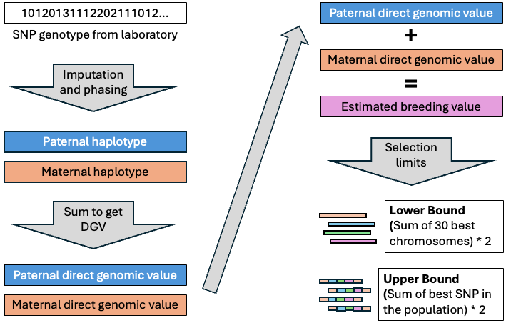

Slide 6
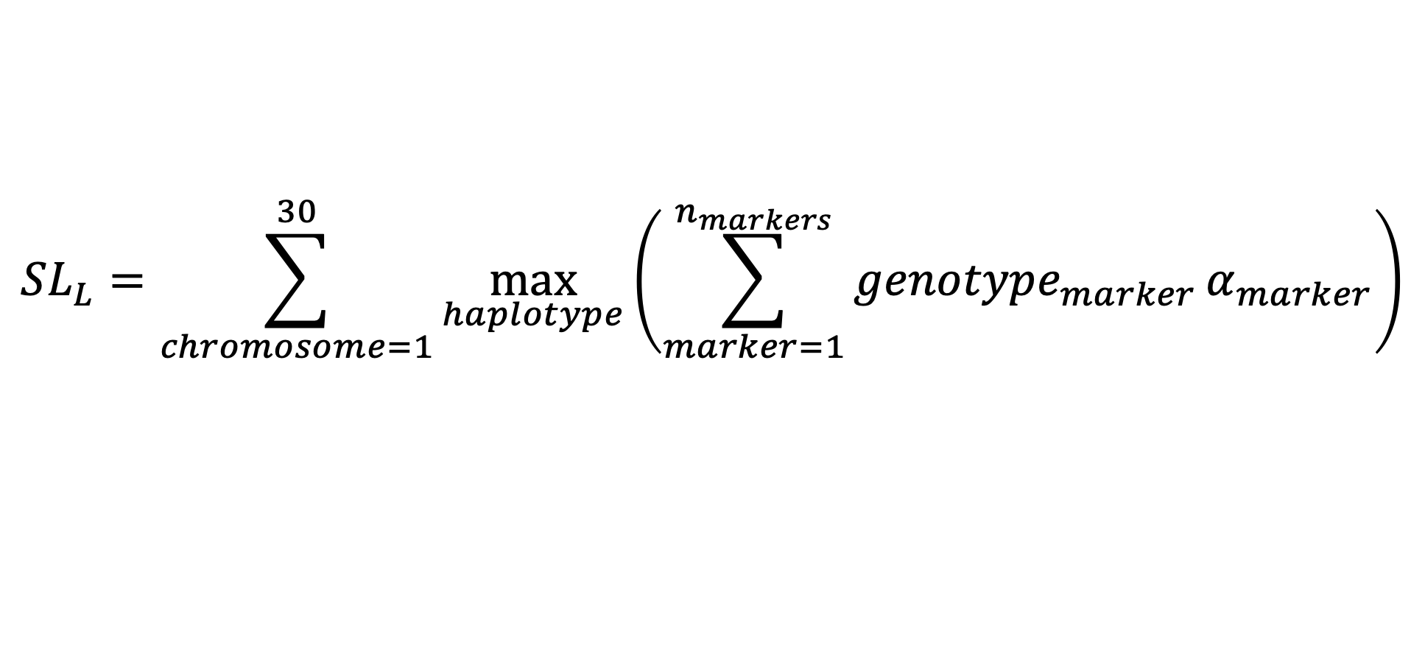
Lower bound selection limit (SL_{L})
Select the 30 best haplotypes for each trait-breed combination
$${SL}_{L}=\sum_{chromosome=1}^{30}{\max_{haplotype}\left(\sum_{marker=1}^{n_{markers}}{{genotype}_{marker}}α_{marker}\right)}$$

Slide 7
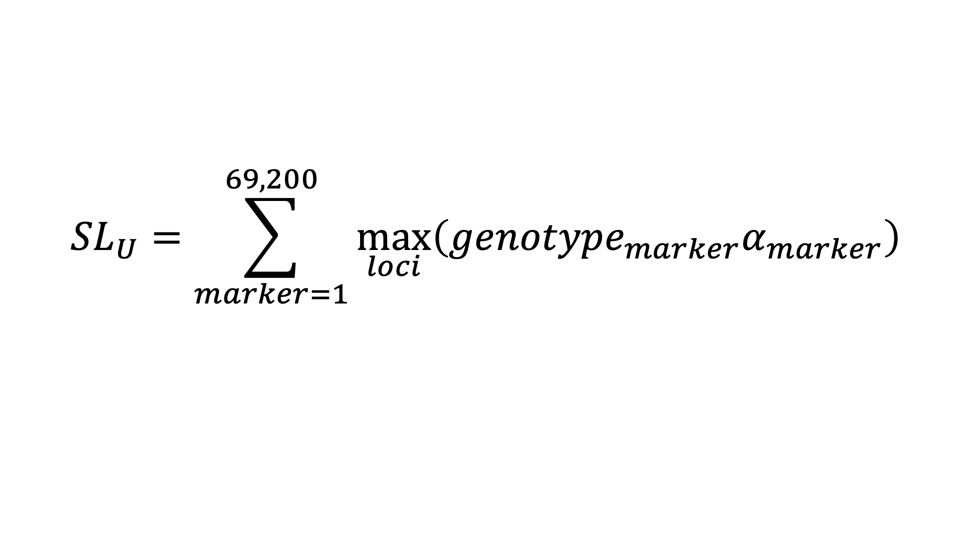
Upper bound selection limit (SL_{U})
Select the 69,200 best markers for each trait-breed combination
$${SL}_{U}=\sum_{marker=1}^{69,200}{\max_{loci}\left({genotype}_{marker}α_{marker}\right)}$$

Slide 8
Estimated selection limits

Slide 9
Summary of findings
A subset of traits was chosen to represent phenotypes with differing heritabilities and varying amounts of available data.
In all cases, DGV_{max} is bounded by SL_{L} and SL_{U}, as expected.
Ratios of SL_{L} to DGV_{max} and SL_{U} to DGV_{max} range from ~2.5 for protein and NM$ in HO to ~16 for milk yield in JE and MAST in HO.
Results are consistent with earlier findings of Cole and VanRaden (2011).

Slide 10
Production traits
Trait | Breed | SL_{L} | SL_{U} | DGV_{max} | SL_{L} to DGV_{max} | SL_{U} to DGV_{max}
Milk | AY | 6,339.49 | 12,888.24 | 1,259.25 | 5.03 | 10.23
 | BS | 11,245.30 | 28,346.49 | 2,759.82 | 4.07 | 10.27
 | GU | 5,804.17 | 12,424.25 | 966.19 | 6.01 | 12.86
 | HO | 16,128.36 | 47,784.84 | 5,044.43 | 3.20 | 9.47
 | JE | 11,716.98 | 40,569.50 | 2,533.73 | 4.62 | 16.01
Protein | AY | 167.89 | 338.86 | 167.89 | 3.65 | 7.36
 | BS | 304.34 | 744.82 | 304.34 | 3.35 | 8.20
 | GU | 157.80 | 340.24 | 157.80 | 4.76 | 10.27
 | HO | 375.20 | 1,215.64 | 375.20 | 2.55 | 8.27
 | JE | 306.90 | 1,130.18 | 306.90 | 3.50 | 12.89

Slide 11
Lifetime profitability and longevity
Trait | Breed | SL_{L} | SL_{U} | DGV_{max} | SL_{L} to DGV_{max} | SL_{U} to DGV_{max}
NM$ | AY | 4,144.15 | 8,393.45 | 908.88 | 4.56 | 9.23
 | BS | 8,085.39 | 18,124.87 | 2,086.48 | 3.88 | 8.69
 | GU | 4,187.75 | 8,318.17 | 744.13 | 5.63 | 11.18
 | HO | 11,704.89 | 39,902.78 | 4,728.14 | 2.48 | 8.44
 | JE | 8,175.53 | 26,400.41 | 2,766.43 | 2.96 | 9.54
PL | AY | 42.60 | 80.19 | 12.92 | 3.30 | 6.21
 | BS | 90.38 | 207.06 | 22.35 | 4.04 | 9.26
 | GU | 46.95 | 80.71 | 15.96 | 2.94 | 5.06
 | HO | 98.48 | 357.82 | 31.62 | 3.11 | 11.32
 | JE | 94.35 | 253.13 | 30.43 | 3.10 | 8.32

Slide 12
Health traits
Trait | Breed | SL_{L} | SL_{U} | DGV_{max} | SL_{L} to DGV_{max} | SL_{U} to DGV_{max}
DSAB | BS | 5.32 | 8.03 | 2.47 | 2.15 | 3.25
 | HO | 25.26 | 77.79 | 4.51 | 5.60 | 17.25
 | JE | 14.23 | 28.02 | 3.48 | 4.09 | 8.05
MAST | BS | 45.96 | 83.90 | 11.45 | 4.01 | 7.33
 | HO | 97.44 | 276.77 | 17.61 | 5.53 | 15.72
 | JE | 66.04 | 137.95 | 14.94 | 4.42 | 9.23
METR | BS | 4.33 | 8.73 | 0.07 | 61.86 | 124.71
 | HO | 42.73 | 100.09 | 9.83 | 4.35 | 10.18
 | JE | 23.69 | 39.64 | 8.35 | 2.84 | 4.75

Slide 13
What’s the best animal we can make?

Slide 15
Holstein chromosomes aren’t always best!
Holstein
Holstein
Jersey
Guernsey

Slide 16
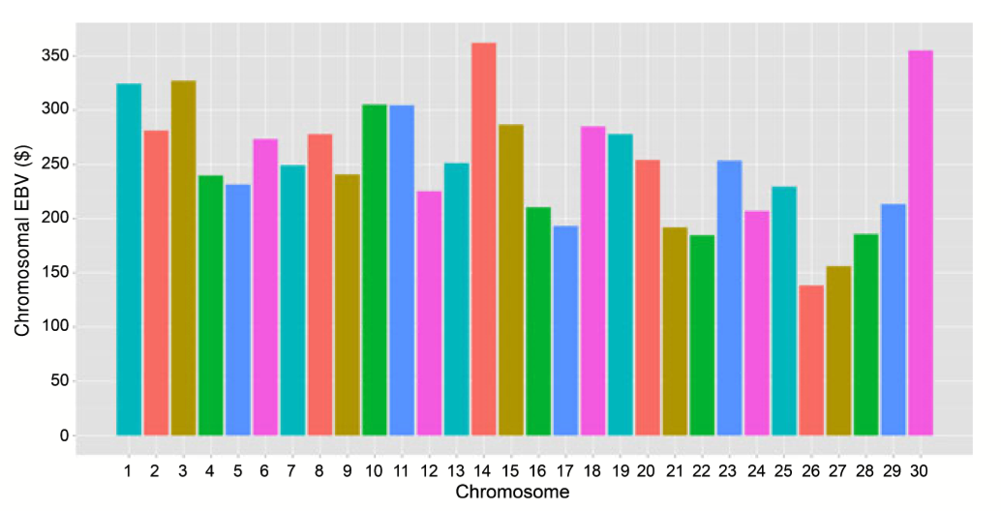
What’s changed since 2010?
Substantially more data are available.
Chromosome 14 no longer dominates the others.
Chromosome 5 is growing in importance.
The pseudo-autosomal region accounts for much smaller effects, on average.
Figure 5 from Cole and VanRaden (2011) showing a Holstein with a potential EBV for NM$ of $7,515.

Slide 17
Discussion and conclusions

Slide 18
Discussion
These results suggest substantial additional selection gains are achievable in all breeds with US genomic evaluations.
Gains may not be additive as populations approach selection limits.
Physiological constraints may limit progress:
  Nutritional requirements may exceed intake capacity or economically viable rations
  Homeostasis may be disrupted, particularly capacity to maintain body temperature
  Genetic and phenotypic correlations assume linearity which may not hold

Slide 19
“When the pure breeds finally reach equilibrium between the production of heterozygosis by mutations and the loss of heterozygosis because the effective number of animals in the breed is small, it is possible that the pure breed may support only a few scores of unfixed loci.”
J.L. Lush (1945)

Slide 20
Conclusions
Selection limits for BS, HO, and JE are similar to results of Cole and VanRaden (2011) .
Selection limits for AY and GU reflect fewer segregations and reduced opportunities to create outlier haplotypes.
Bounds on achievable EBV range from an average of 3.45 for SL_{L} to 7.44 for SL_{U}.
Substantial opportunity for genetic progress remains in the US dairy cattle population.

Slide 21
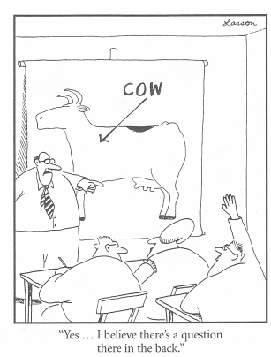
Questions?
Thank you for your
attention!
john.cole@uscdcb.com

